Slide 1

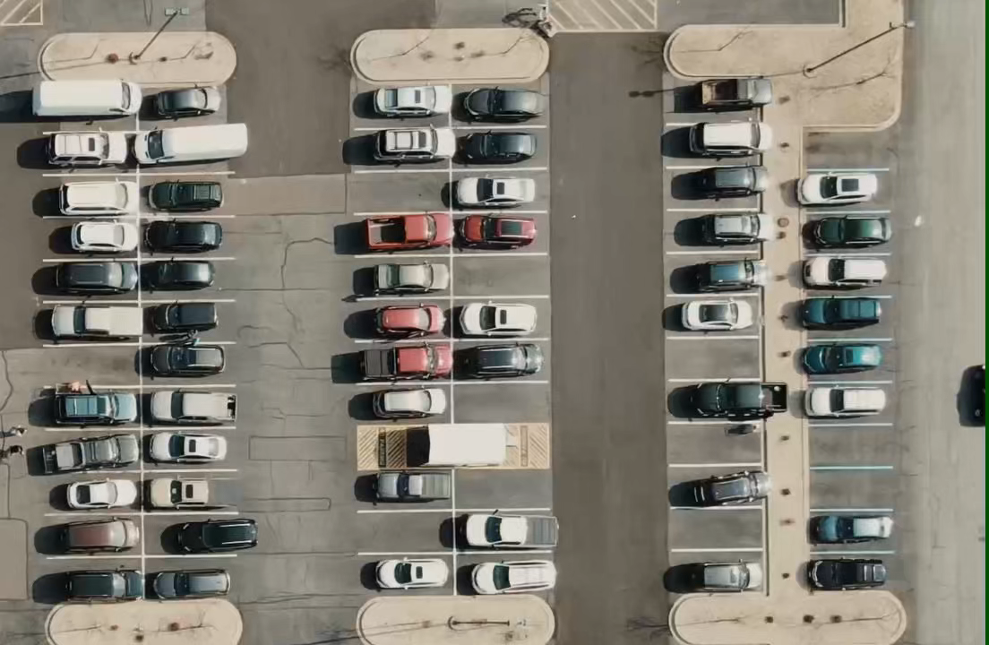
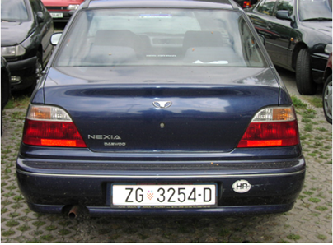
Car parking 3.0
in this project we realize a code that simulate a quite smart parking that is able to
Recognize car license plate of the veichle inside
From a camera put on the top, counting in real time
Wich park are taken
The parking available
Photo taken from enter
Video of the parking from the top

Slide 2
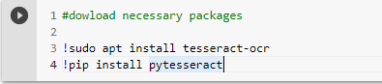
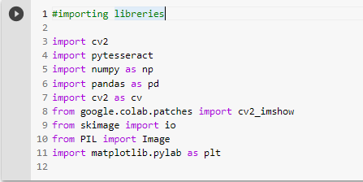
License plate recognize
This project has been implemented in phyton language using colab, a very usefull ide implemented by google.
Before starting we have to install pytesseract, a library for CV that allow us to traslate a word inside a photo in a string var.
Here we import the necessary library usufull for our project.

Slide 3
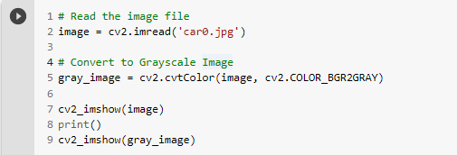

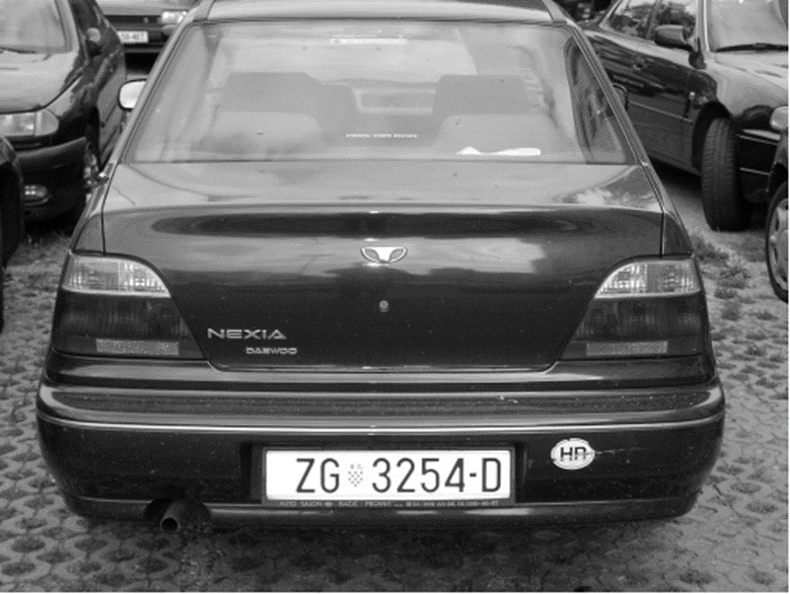
Gray scale
INPUT:
GRAY FILTERING
DESCRIPTION OF CODE:
We import the origin image with cv2_library
converting the initial image in gray one, applying a gray_ filtering in cv2_library using the : cv2.COLOR_BGR2GRAY code
This simplify canny edge detection to detect the edges
OUTPUT

Slide 4
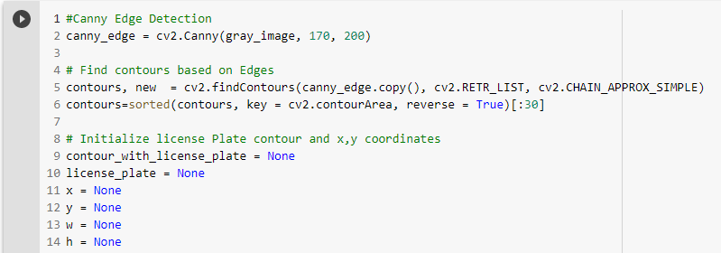
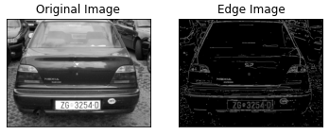
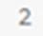
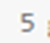
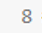
Parameters of tesseract library
DESCRIPTION OF CODE:
Using canny edge detection we detect all edges of the image
With find countours applicated at canny edge we save the contour of the image,specifing the mode of retrivial ( 2’ parameter) and the approximation ( 3’ parameter )
With sorted we put in order the contours found, deleting that ones are < 30
Than we initilize license plate variable defined by (x+w) (y+h) coordinate of initial image
CHAIN APPROX_SIMPLE

Slide 5
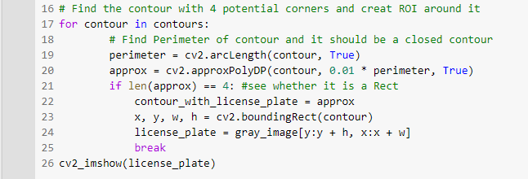
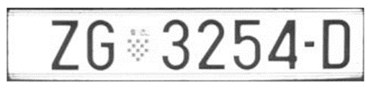
Parameters of tesseract library
OUTPUT:
DESCRIPTION OF CODE:
Analizing all countour find with a for loop
Misuring the lenght of each with arc lenght
And using approxPolyDP we search in contours known figures like rectangular with 0,01 precision to identify the the region of the original image where there is licence plate.
If we found the rectangle, we found the licence plate, so we save the coordinates in the datas created before.

Slide 6
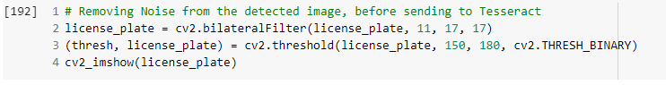
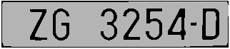
bilateral filter
INPUT:
Before filtering
OUTPUT:
After filtering
Bilateral filtering
DESCRIPTION OF CODE:
For removing noise we apply: Bilateral filter -> to clean the license plate smothing the image
Binary threshold -> to increase the contrast ( helping pytesseract library to capture the letters )

Slide 7
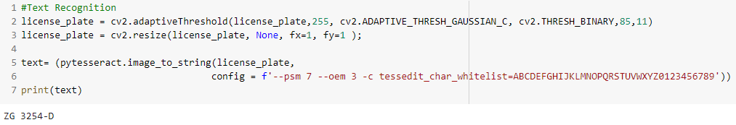
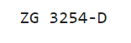
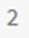
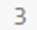
Parameters of tesseract library
OUTPUT: ora la targa è una stringa manipolabile
DESCRIPTION OF CODE:
To allow pytesseract library to capture the string of the license plate is still necessary to manipulate the region of interest of the image with other filtering:
adaptive_thresh_gaussian and thresh_binary filter
trying to resize the image
With pytesseract.image_to_string code we capture at the end the license plate and we save it in a string variable that can be manipulate in the future

Slide 8
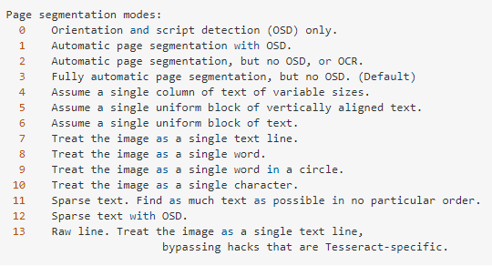
Parameters of tesseract library
To capture the license plate ‘’ pytesseract.image_to_string ‘’ has to be proper config.
psm:
tessedit_char_whitelist:
Limit the function at a preset of char (white list) while we known the licence plate is composed by 0-9 and A-Z char.

Slide 9
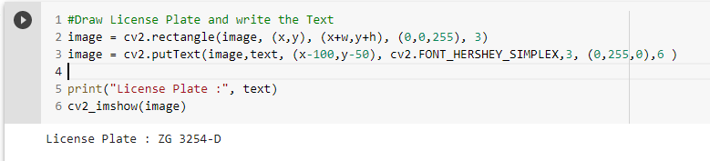
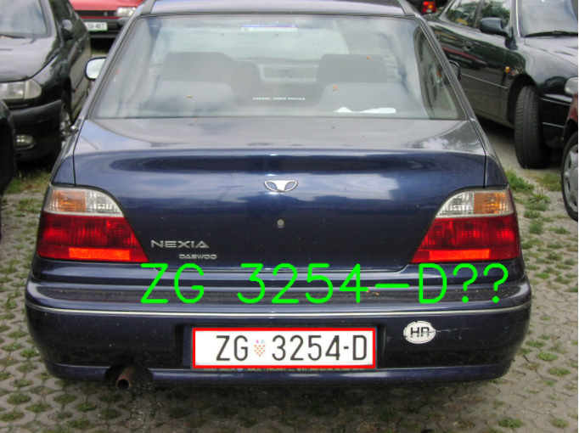
Final output
RESULT
DESCRIPTION OF CODE:
Overlap rectangle we found to the initial image to identify the license plate
Hold on the text found with pytesseract in the string variable to
See that it can be now manipulate.

Slide 10
Parking counter
This part of the project consist to count the parking place in real time video with an interactive code.
The code is divided in 2 programmes:
recognizing parking space
Counting in real time parking taken

Slide 11
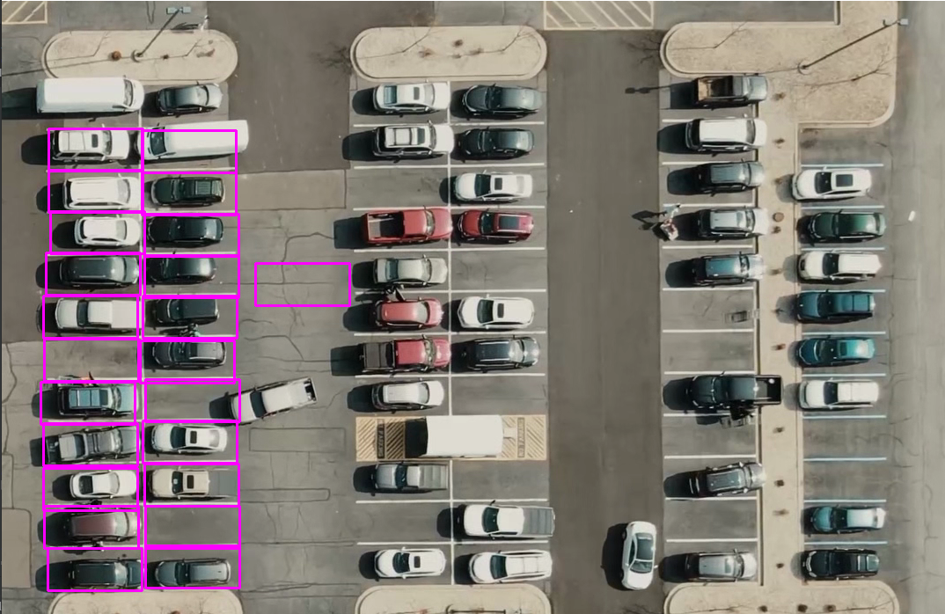
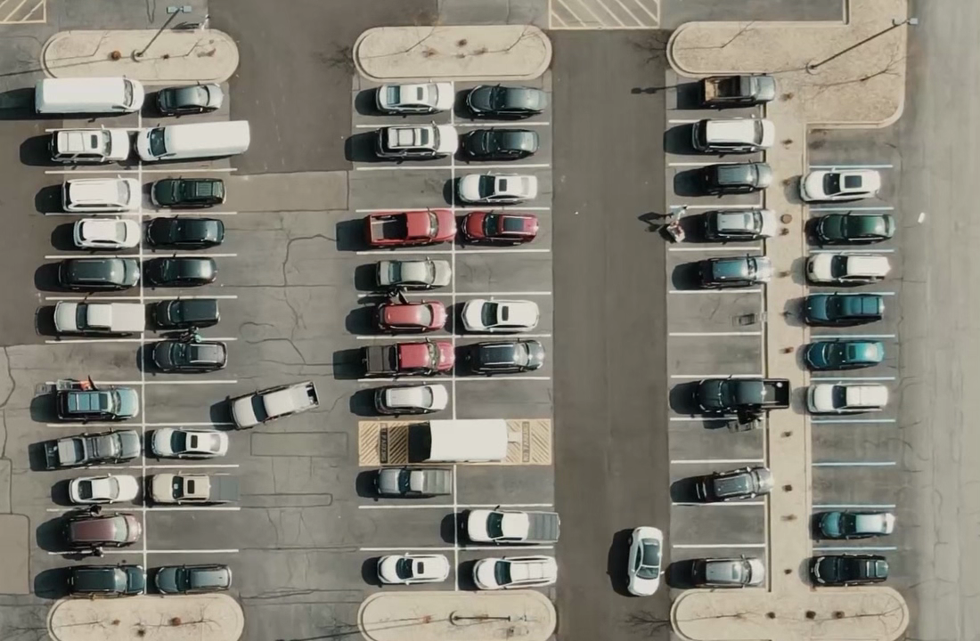
Recognizing parking space
We pick manually each parking with mouse
We save them into a file to export at the other programme
From a photo of the entire parking

Slide 12
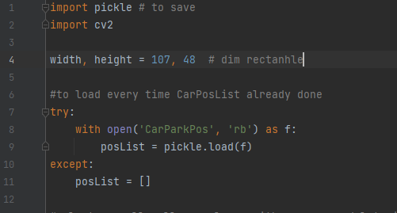
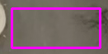
Recognizing parking space
Variable rectangle
DESCRIPTION OF CODE:
Import necessary lib
Creating a variable rectangle with the same dimesion of the parking
We load the file with parking already found early

Slide 13
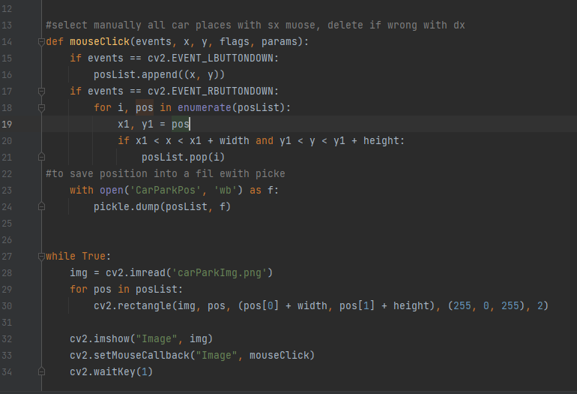
Select parking space
DESCRIPTION OF CODE:
Defining the click muose variable to select zone with the mouse in the photo
Sx_button to mark zone
Dx_button to delete zone already marked (wrong)
Saving position marked into a file named « CarParkPos »
Show parking image and and each rectangle depicted

Slide 14
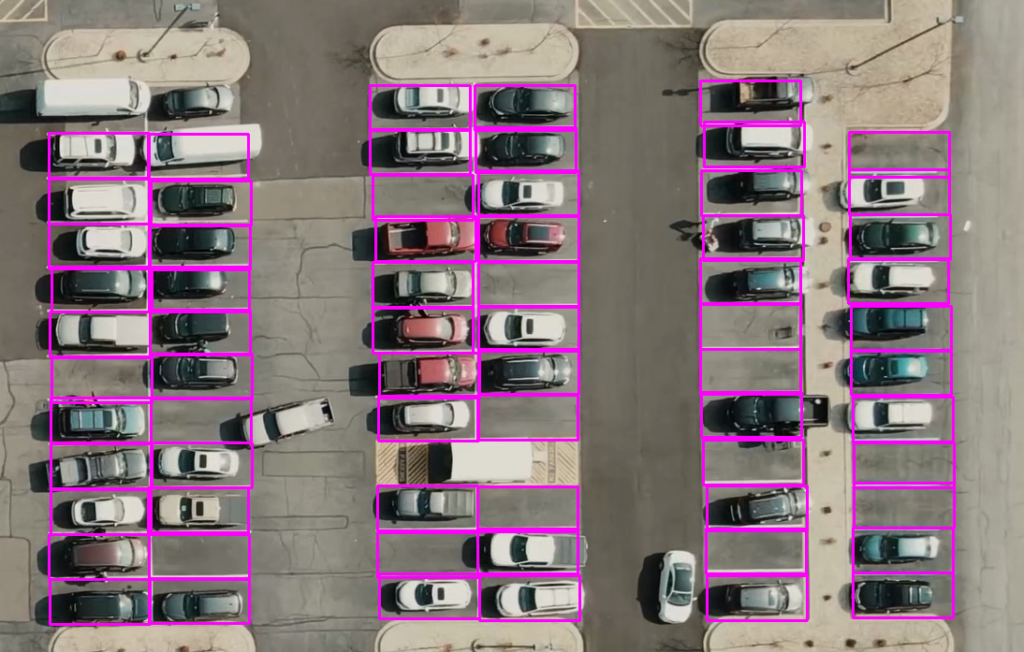
Final output progrsmme 1
Final output of the first programme

Slide 15
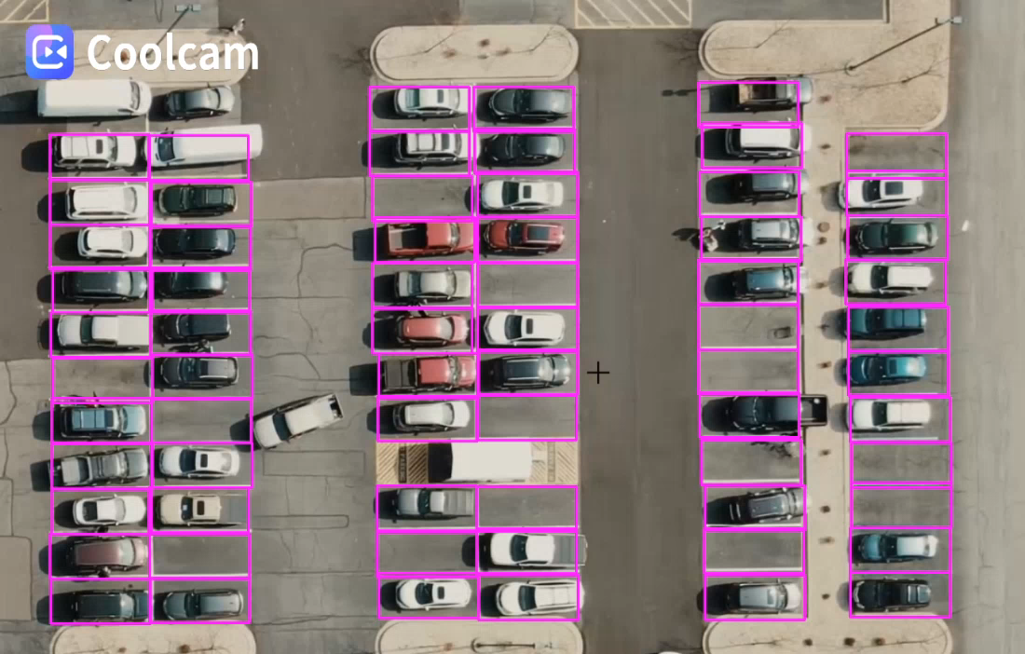
counter parking space
We overlap the file created early to identify in the video the zone of parking.
We manipulate each zone to see if there or not the car to count them.
Starting from the video of the parking

Slide 16
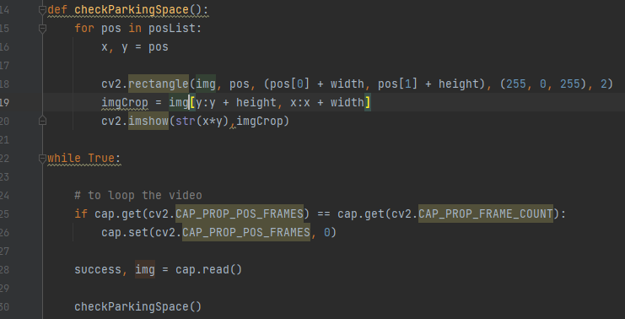
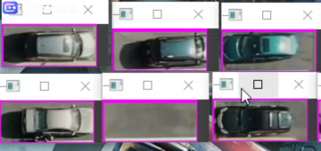
Separation of parking
we separete each parkin in a small portion of video to manipulate it
DESCRIPTION OF CODE:
Inside checkParkingSpace we define the portion of the video of each parking
output

Slide 17
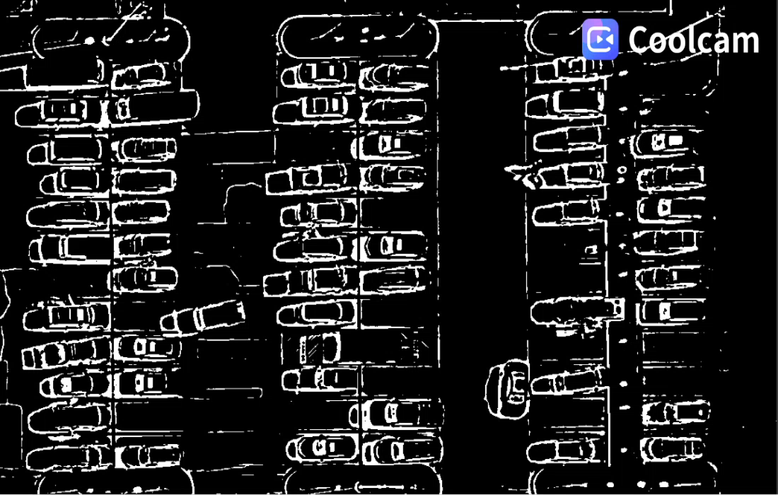
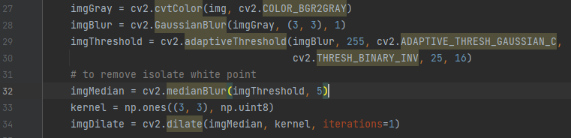
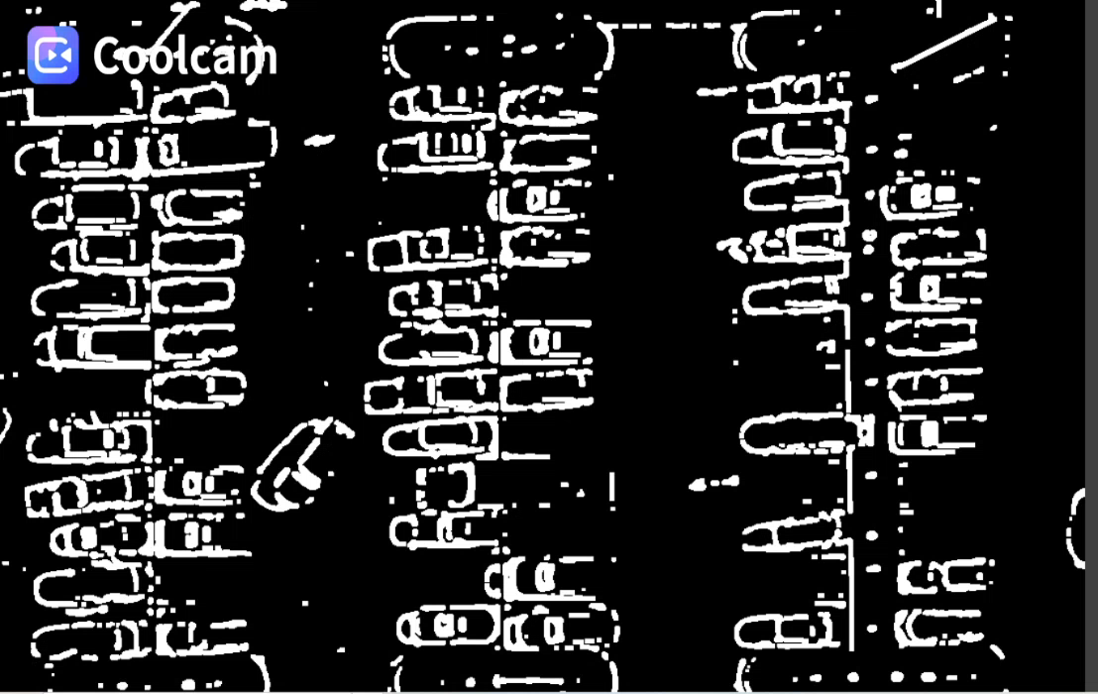
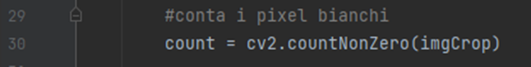
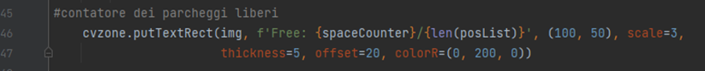
Manipulation and counter
we filter image to black and white (binary image)
If there are many corner and edges -> we have a car
if there are a bit of them -> we don’ t have a car
Now we have to
Count pixel of every cutting region:
Pixel > threshold (900) -> taken
Pixel < threshold (900) -> free
count every time the number of cutting region wich have pixel > threshol

Slide 18
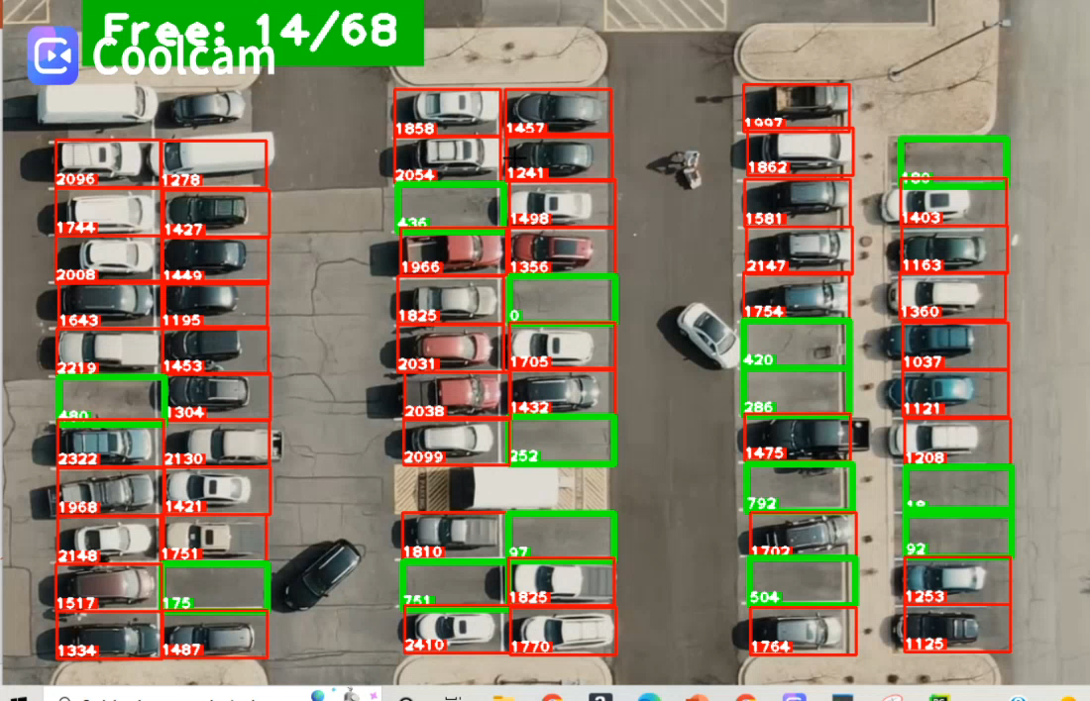
Final output

